Slide 1
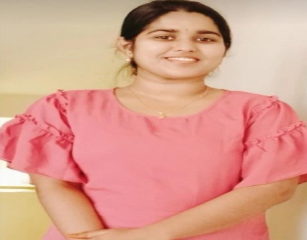
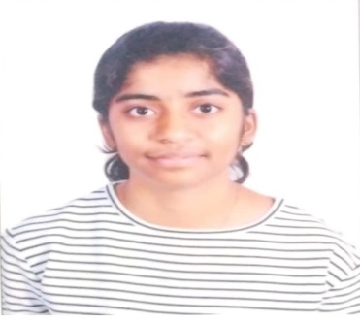
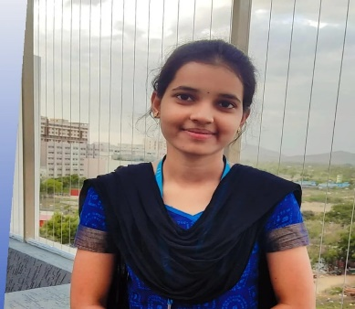

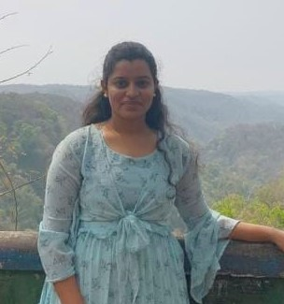
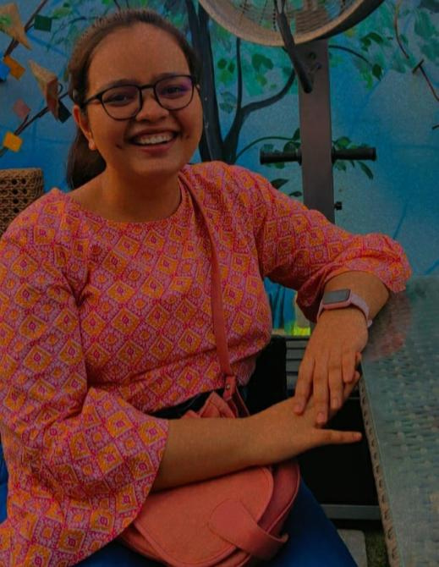
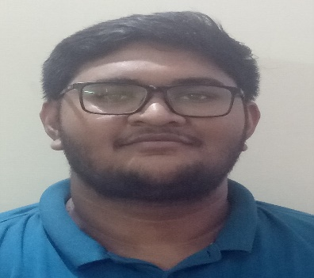

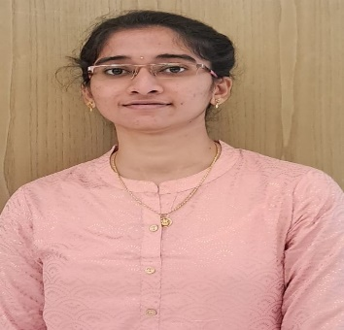
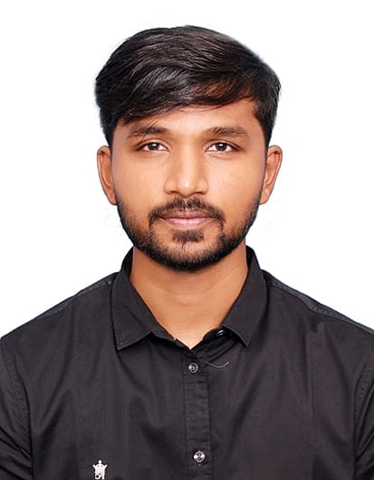
AUTO-MEET-200
1. Front End Development 2. Database Management
Kodali Naga Vigneswari Meghana Reddy Manda Keerthana K Pranshu Yadav Indukuri Namratha Gayathri
3. Back End Development 4. Testing and Documentation
Ishita Srivastava Divyansh Pal Piyush Mehta Sri Likhitha Lankireddy Dinesh

Slide 2
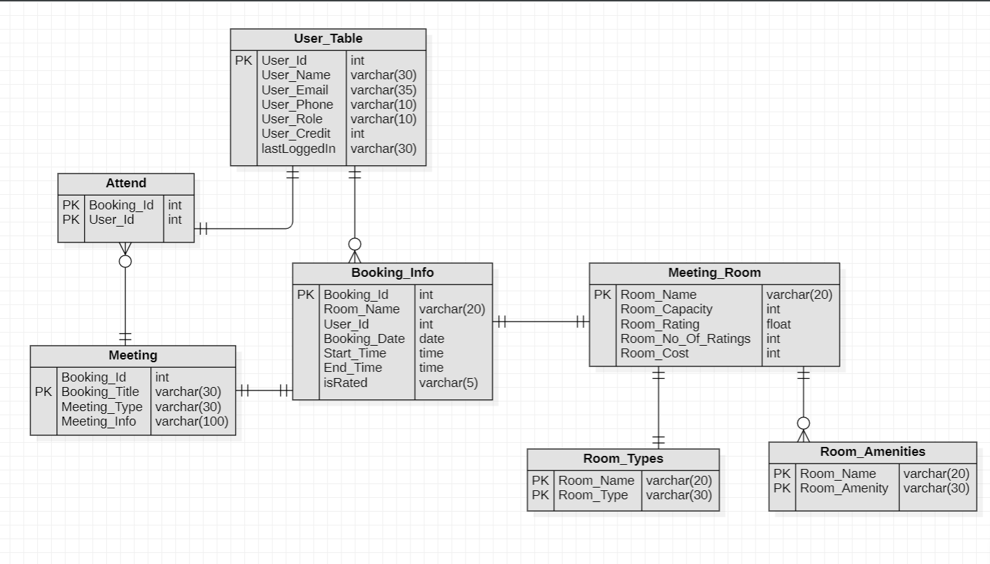
ER Diagram

Slide 3
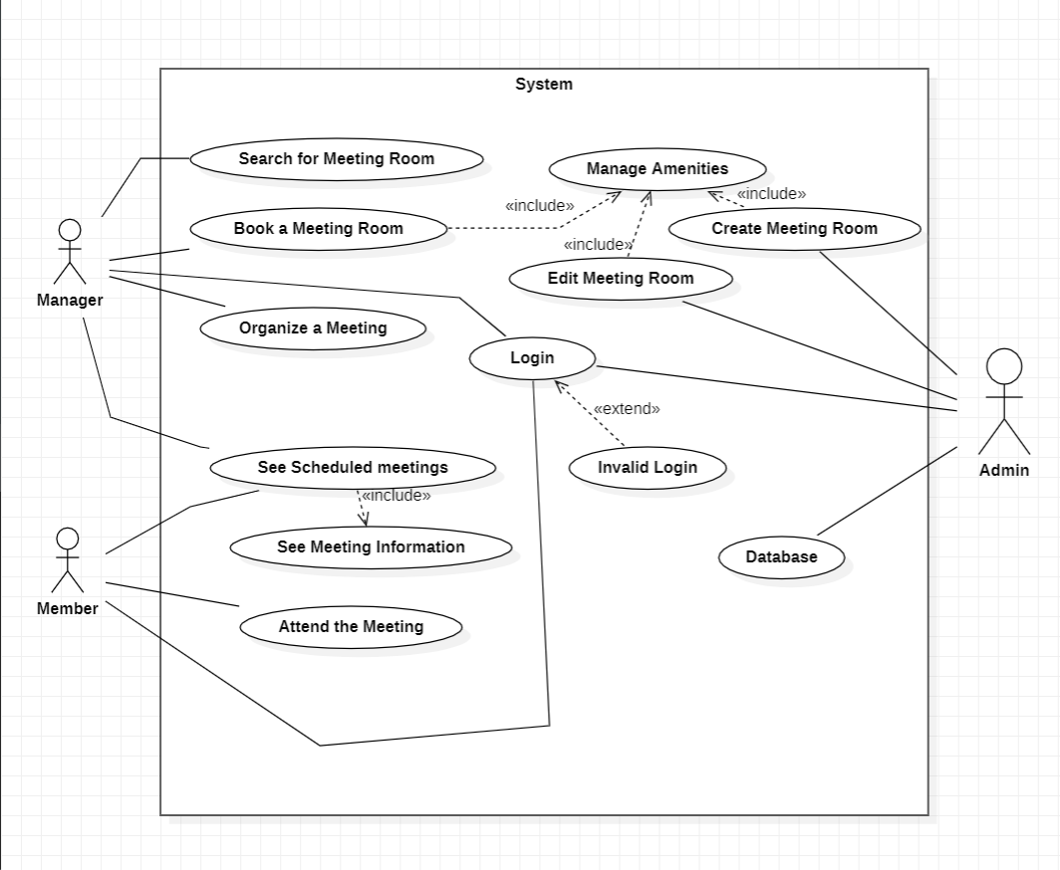
Use Case Diagram

Slide 4
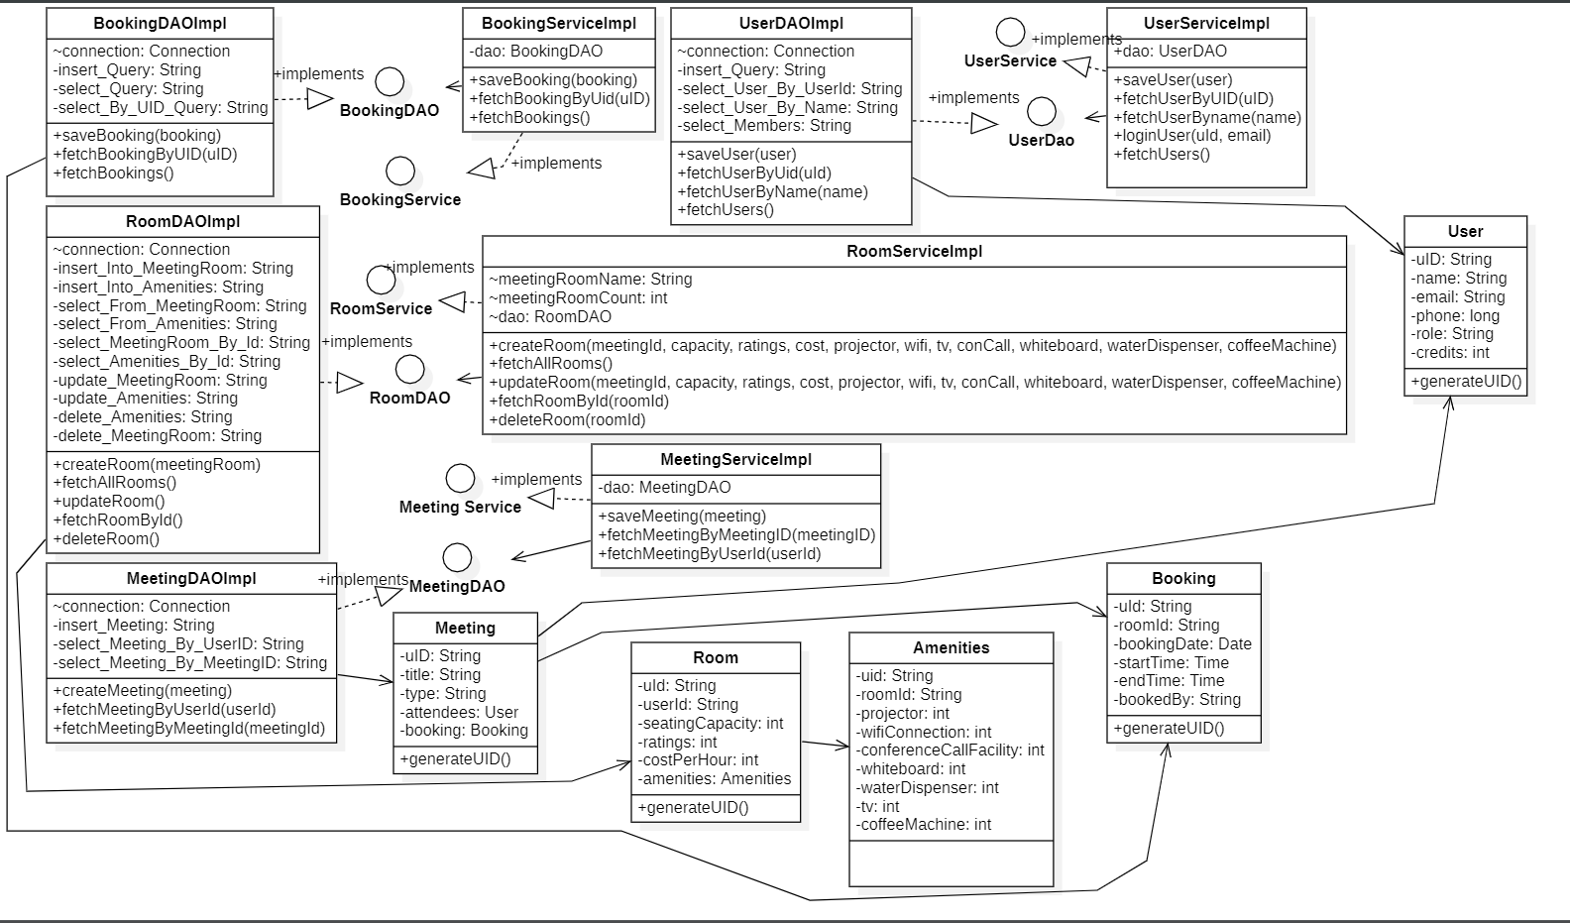
Class Diagram

Slide 5
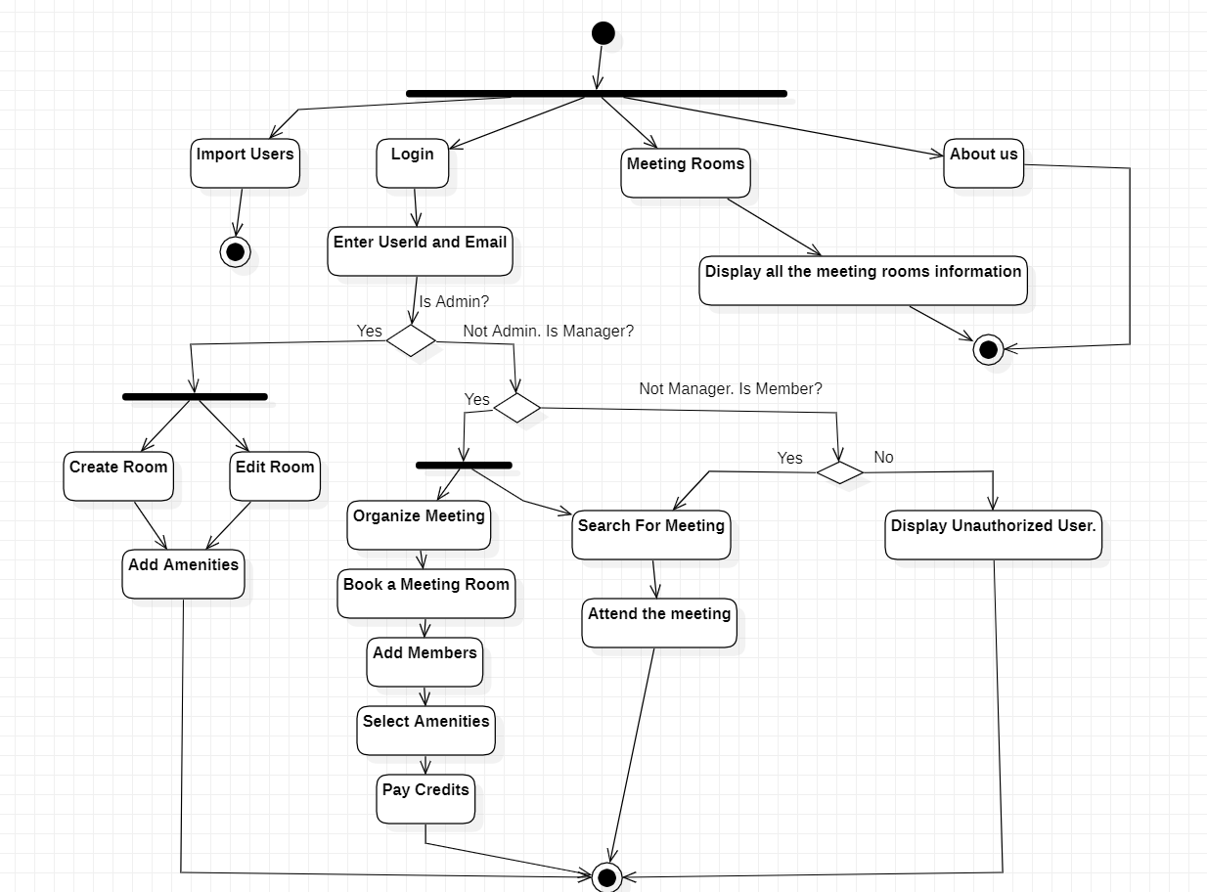
Data Flow Diagram

Slide 6
User Interface

